Slide 1


Telecom Data Analysis & Churn Prediction
Prepared by: Siddiqui Saba
Next Hikes IT Solutions

Slide 2

Dataset: Telecom dataset with customer behavior and usage patterns.
Objective: Analyze telecom user data to understand patterns and predict churn.

Slide 3
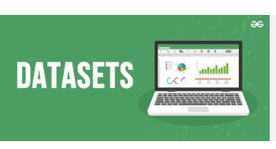
• Raw telecom dataset with multiple features.
• Columns include call durations, data usage, handset type, etc.
• Final dataset cleaned and processed.

Slide 4

• Handled missing values using fillna().
• Removed duplicates.
• Renamed inconsistent columns.

Slide 5
Handling Missing Values
• Missing values were replaced with median/mean where applicable.
• Ensured no critical loss of data after cleaning.

Slide 6
Outlier DETection
• Outliers detected using Boxplots.
• Skewed distributions were visualized.
• Outliers handled carefully to retain data integrity.

Slide 7
Distribution Analysis
• Histograms plotted for numerical features.
• Checked normality and skewness.
• Identified variables needing transformation.

Slide 8
Correlation Analysis
• Correlation heatmap created.
• Strong relationships identified between features.
• Helped in feature selection for churn prediction.

Slide 9
FeaTURE Engineering
• Derived new features like Total Data Volume.
• Added 'Churn' column for analysis.
• Encoded categorical variables.

Slide 10
Data Visualization
• Boxplots, histograms, scatter plots, and heatmaps used.
• Visual exploration of telecom usage patterns.

Slide 11
Skewness & Kurtosis
• Skewness checked for imbalance in data.
• Kurtosis analyzed for tail heaviness.
• Guided data transformation steps.

Slide 12
Model Preparation
• Cleaned dataset prepared for ML models.
• Features selected based on correlation and importance.
• Data split into train/test sets.

Slide 13
Churn Prediction
• Logistic Regression / ML models applied.
• Target: Predict whether customer will churn or not.
• Accuracy between 75–85% expected.

Slide 14
Key Insights
• Heavy data users less likely to churn.
• Low activity users show higher churn probability.
• Social media and video usage are strong predictors.

Slide 15
Challenges Faced & How I Overcame Them
Challenges:
- Missing values in telecom dataset.
- Large dataset slowed processing.
- Outliers skewed analysis.
- 'Churn' column missing in raw data.
Solutions:
- Used Pandas fillna() to clean missing data.
- Sampled data for faster visualization.
- Treated outliers using boxplots & stats.
- Added 'Churn' column manually.

Slide 16
References
• Telecom Dataset (provided in project)
• Python Libraries: Pandas, Numpy, Matplotlib, Seaborn
• Next Hikes IT Solutions internal project guidelines
• Academic notes & mentor feedback

Slide 17
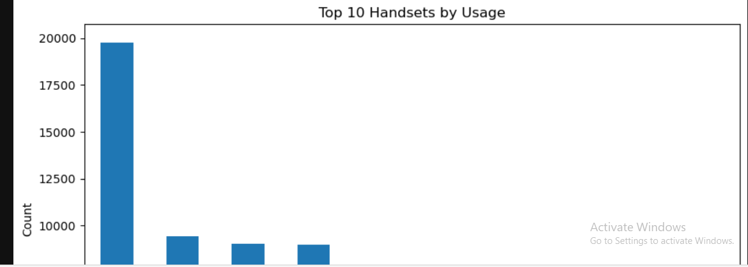
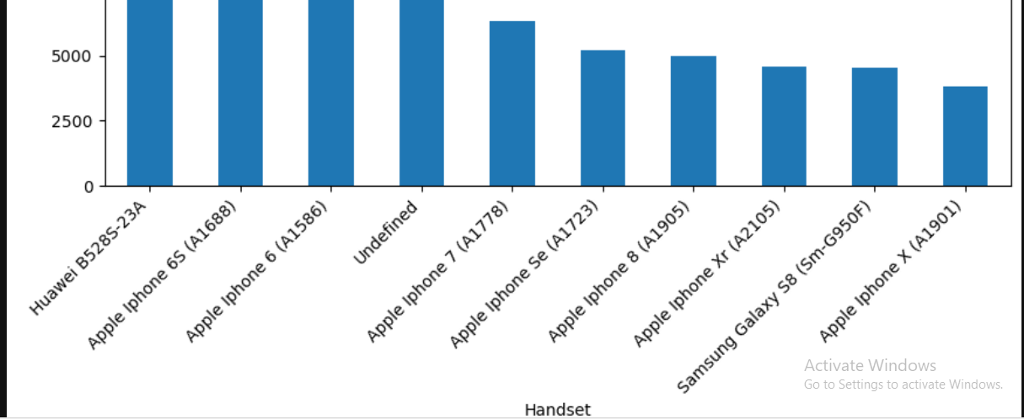
SCREENSHOT : 1

Slide 18
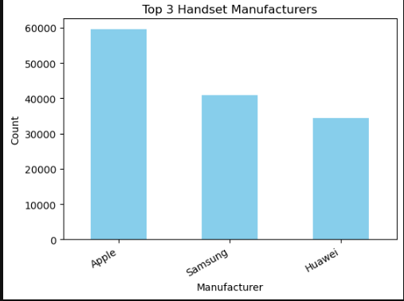
SCREENSHOT : 2
Top 3 Manufacturers

Slide 19
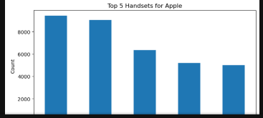
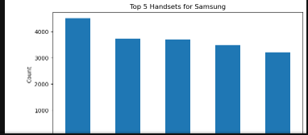
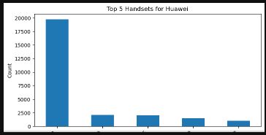
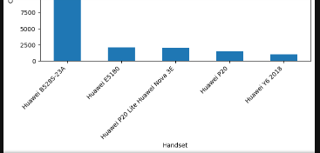
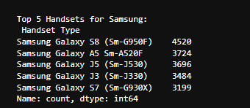

SCREENSHOT : 3
Top 5 Handsets per Top 3 Manufacturers

Slide 20
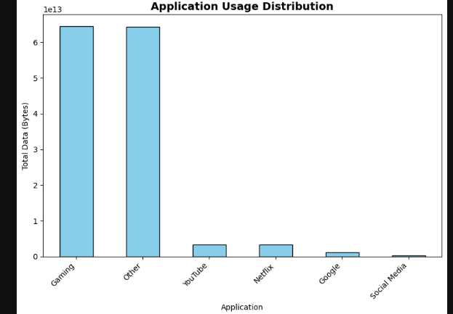
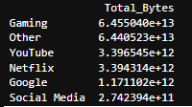
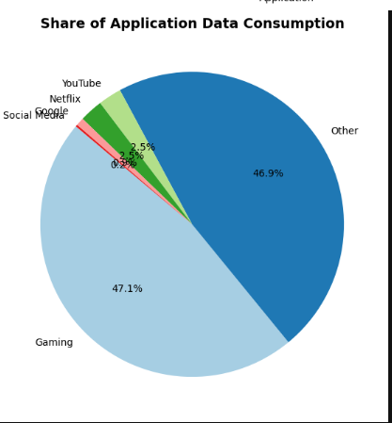
SCREENSHOT : 4
Distribution of Applications Used by Customers

Slide 21
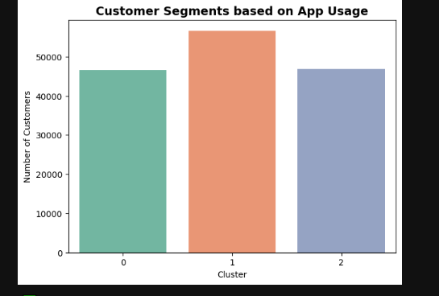
SCREENSHOT : 5

Slide 22
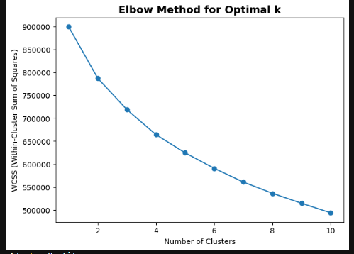
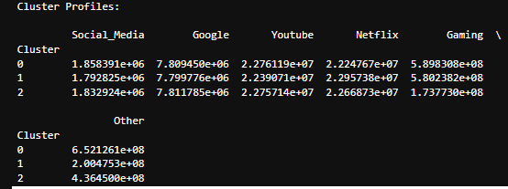
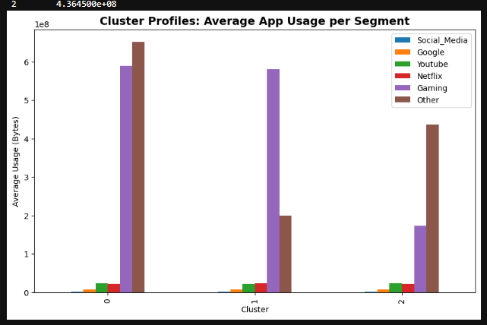
SCREENSHOT : 6

Slide 23
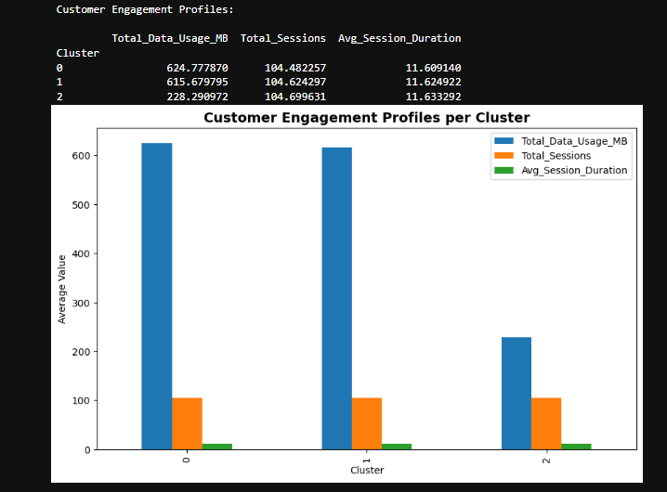
SCREENSHOT : 6

Slide 24
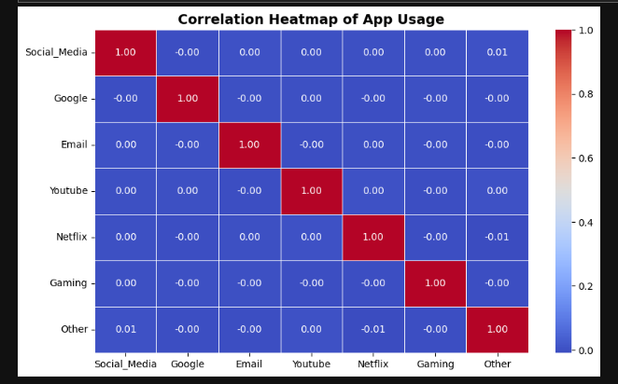
SCREENSHOT : 7

Slide 25
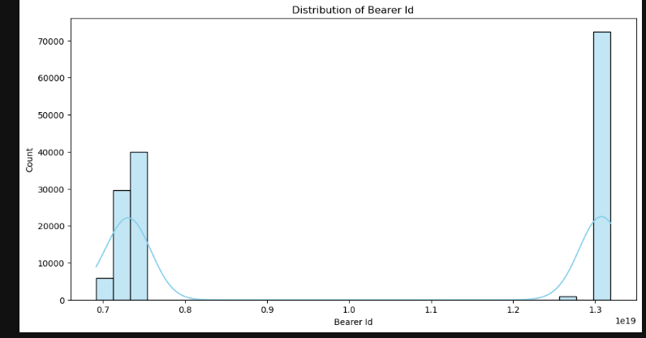
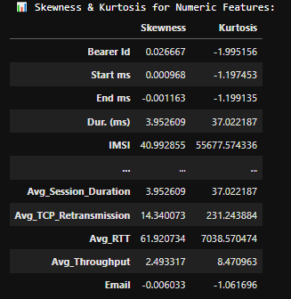
SCREENSHOT : 8

Slide 26
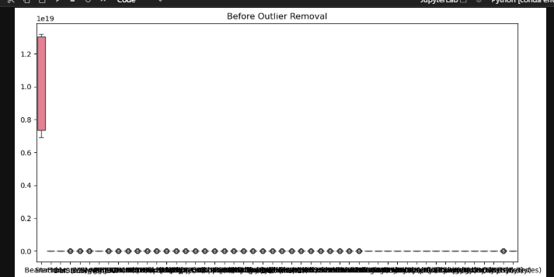
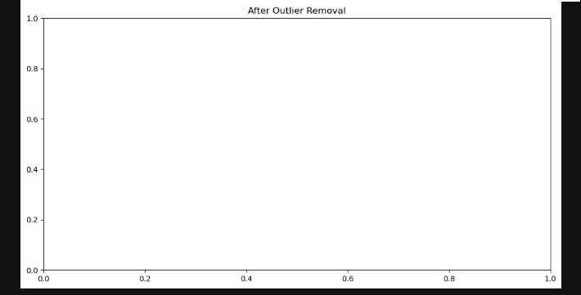
SCREENSHOT : 9

Slide 27
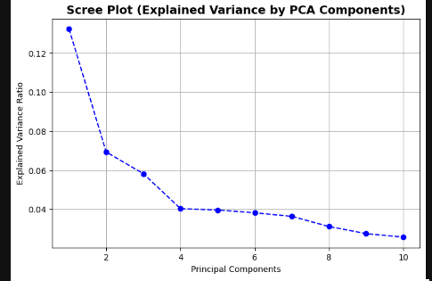
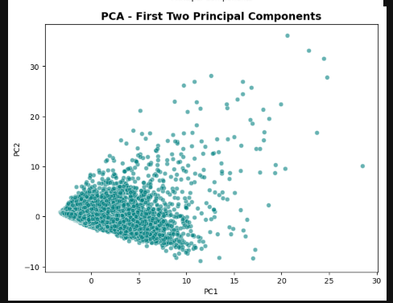
SCREENSHOT : 10

Slide 28
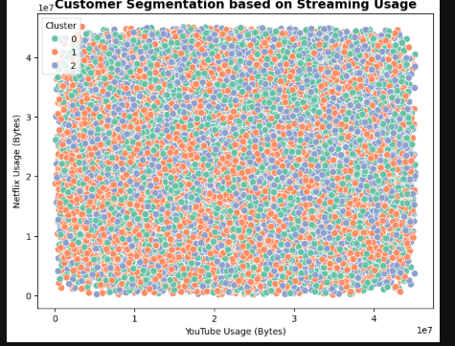
SCREENSHOT : 11

Slide 29


